Slide 1
Data Structures and Algorithms -3 (25CS2103E)
Symptom-to-Diagnosis Matcher
Team Members
Name: Anirudh konjeti Rollno:2520080028
Name:Ram Mohan Agarwal Rollno:2520090037
Under the Esteemed Guidance of
Mrs. Ch. Anitha
Asst. Professor, CS&IT

Slide 2
Contents
Abstract
Introduction
Literature survey
Problem Statement and Objectives
Hardware and Software requirements
Results
Conclusion
Future Scope

Slide 3
Abstract
This project presents a decision-support engine that maps free-text patient symptom descriptions to likely medical diagnoses in a transparent, explainable manner. The system first normalizes raw symptom text — handling synonyms, misspellings, negations, and varied phrasing — into standardized clinical terms. It then scores candidate diagnoses from a structured medical knowledge base using a weighted matching algorithm that accounts for symptom specificity, frequency of co-occurrence, and evidence strength, producing a ranked differential diagnosis list with interpret able confidence scores rather than opaque probabilities. To help narrow ambiguity between top candidates, the engine identifies which additional clinical tests would most effectively discriminate among the remaining possibilities, using an information-gain-style approach to recommend a minimal, targeted test set rather than exhaustive screening. The result is a lightweight, audit able clinical reasoning aid intended to support — not replace — clinician judgment, emphasizing traceability of every score back to underlying symptom-condition evidence so users can understand exactly why a diagnosis was suggested.

Slide 4
Introduction
Diagnosing diseases from symptoms can be challenging because different diseases may share similar symptoms.
Patients may describe symptoms using different terms, misspellings, synonyms, or incomplete sentences.
The Symptom-to-Diagnosis Matcher processes this free-text input and converts it into standardized clinical symptoms.
It compares these symptoms with a structured medical knowledge base and ranks the most likely diagnoses.
The system provides interpretable confidence scores and explains which symptoms contributed to each result.
It can recommend targeted medical tests to differentiate between closely related conditions.
The system is designed as a decision-support tool for healthcare professionals, not as a replacement for doctors.

Slide 5
Literature Survey
Traditional Rule-Based Systems: Early medical diagnosis systems used predefined rules to match symptoms with diseases. They are easy to understand but may have limited flexibility.
Machine Learning Approaches: ML techniques such as Decision Trees, Naive Bayes, and SVM have been used to predict diseases from symptom patterns.
Natural Language Processing (NLP): NLP methods help extract meaningful medical information from free-text patient descriptions, including synonyms and variations in wording.
Knowledge-Based Systems: Medical knowledge bases connect diseases with their associated symptoms and provide evidence for possible diagnoses.
Explainable AI (XAI): Recent systems focus on explaining why a particular diagnosis is suggested, improving transparency and user trust.
Research Gap: Many existing systems focus mainly on prediction, while fewer combine free-text symptom processing, explainable diagnosis ranking, and targeted test recommendations in a lightweight system.

Slide 6
Problem Statement and Objectives
Problem Statement
Patients describe symptoms in different words, incomplete sentences, or with spelling mistakes.
Similar symptoms can be associated with multiple diseases, making diagnosis difficult.
Existing systems may provide predictions without clearly explaining why a diagnosis was suggested.
There is a need for an accurate, transparent, and explainable symptom-based decision-support system.
Objectives
Convert free-text symptom descriptions into standardized medical terms.
Match symptoms with a medical knowledge base to identify possible diagnoses.
Rank diagnoses based on symptom relevance and evidence strength.
Provide explainable results showing why a diagnosis is suggested.
Recommend additional targeted tests to differentiate similar conditions.
Support healthcare professionals' decision-making, not replace doctors.

Slide 7
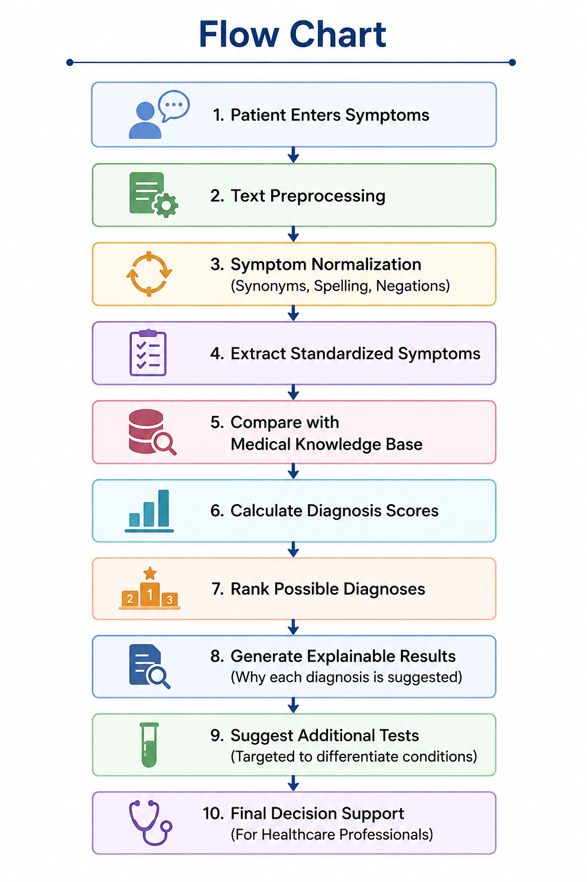
Flow Chart

Slide 8
Results
Successfully maps patient symptom descriptions to likely medical diagnoses.
Symptom text is normalized to handle synonyms, spelling variations, and different expressions.
The system identifies relevant symptoms and compares them with the available disease knowledge base.
Provides a ranked list of possible diagnoses instead of a single unexplained prediction.
Uses an explainable approach, showing the symptoms that contributed to the predicted diagnosis.
Helps users understand possible conditions and supports preliminary clinical decision-making.
The system is designed as a decision-support tool and not a replacement for professional medical diagnosis.

Slide 9
Hardware and Software requirements
Hardware Requirements
Standard laptop/desktop computer
Minimum 4 GB RAM
1 GB free storage
Software Requirements
Operating System: Windows 10/11
Programming Language: Java
JDK: Java 17 or above
IDE: IntelliJ IDEA / Eclipse / VS Code
Data Structures: HashMap, ArrayList, Trees, etc.

Slide 10
Conclusion
The Symptom-to-Diagnosis Matcher successfully maps user-provided symptoms to possible diseases.
Java data structures and algorithms are used to efficiently store, search, and match symptom–disease information.
The system provides understandable and ranked diagnosis suggestions based on the entered symptoms.
It demonstrates how DSA concepts can be applied to solve a practical healthcare-related problem.
The system is intended as a decision-support tool and does not replace professional medical diagnosis.

Slide 11
Future Scope
Add a larger and more detailed symptom–disease database.
Improve matching accuracy using advanced algorithms and NLP techniques.
Add a user-friendly graphical interface for easy symptom input.
Provide severity levels and more detailed diagnosis suggestions.
Add more languages to make the system accessible to more users.
Integrate the system with healthcare databases or APIs for updated medical information.
Develop a web or mobile application for real-time use.

Slide 12
Thank you

